Slide 1
Virtual Point in Time Access
Assaf Natanzon EMC, Ben Gurion University
Prof. Eitan Bachmat, Ben Gurion University

Slide 2
Outline
Motivation
Background on RecoverPoint replication
Virtual Image access algorithm
Performance analysis
Q&A

Slide 3
Motivation

Slide 4
Motivation for any point in time recovery
Fine granular restore of single object
Binary search for a good version of an object
DR testing of point in time of the storage.

Slide 5
RecoverPoint Architecture

Slide 6
Basic deployment
Servers
Servers
SAN
SAN
FC/WAN
RecoverPoint
RecoverPoint
LUN
LUN
LUN
Production LUNs
Disaster recovery journal
Disaster recovery replicas

Slide 7
Splitter location
Splitter can be
Array-based
Fabric-based
Host-based
Host
Splitter
Storage
RPA

Slide 8
Journal management process
Write Do
5-Phase Distribution
Read Do
Remote RPA
Read Undo
Write Undo
Do
Undo
Write Do
Journal
Replica Volume

Slide 9
Building Virtual Image
Partition/map
Reduce
Merge
Meta data sub log
sorted/filtered meta log
Meta data sub log
sorted/filtered meta log
Meta data sub log
sorted/filtered meta log
Meta data sub log
sorted/filtered meta log
Meta data sub log
sorted/filtered meta log
Undo log meta data
Meta data log
Meta data sub log
Sort and filter
sorted/filtered meta log
Meta data sub log
sorted/filtered meta log
Meta data sub log
sorted/filtered meta log
Meta data sub log
sorted/filtered meta log
Meta data sub log
sorted/filtered meta log
Meta data sub log
sorted/filtered meta log
Meta data sub log
sorted/filtered meta log

Slide 10
Point in time virtual image of the storage
The system creates a virtual image of the volume at the point in time the user requested.
The storage exposes the data at the same LU as the replica volume.
IOs arriving at the replica volume are redirected at the RPA and data is fetched from the correct location (either the journal or the replica).

Slide 11
I/O Distribution Process
Application host
5-Phase Distribution
Remote RPA
splitter
Do
Requested point in time
Undo
Journal
Replica Volume

Slide 12
Data structure Requirements
The system creates a data structure which contains the meta data describing the volume
The structure must answer the following query: Given an offset and a length, where are the relevant blocks located?

Slide 13
Building the data structure
We formalize the building of the data structure in a Map/Reduce formulation.
The data structure needs to produce a pointer to the earliest location in the relevant portion of the journal covering the required point in time.

Slide 14
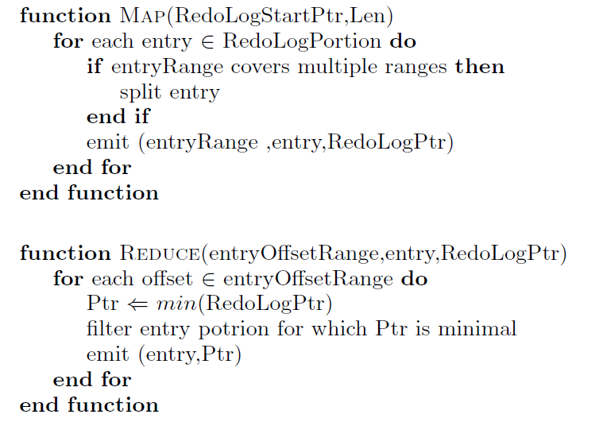

Slide 15
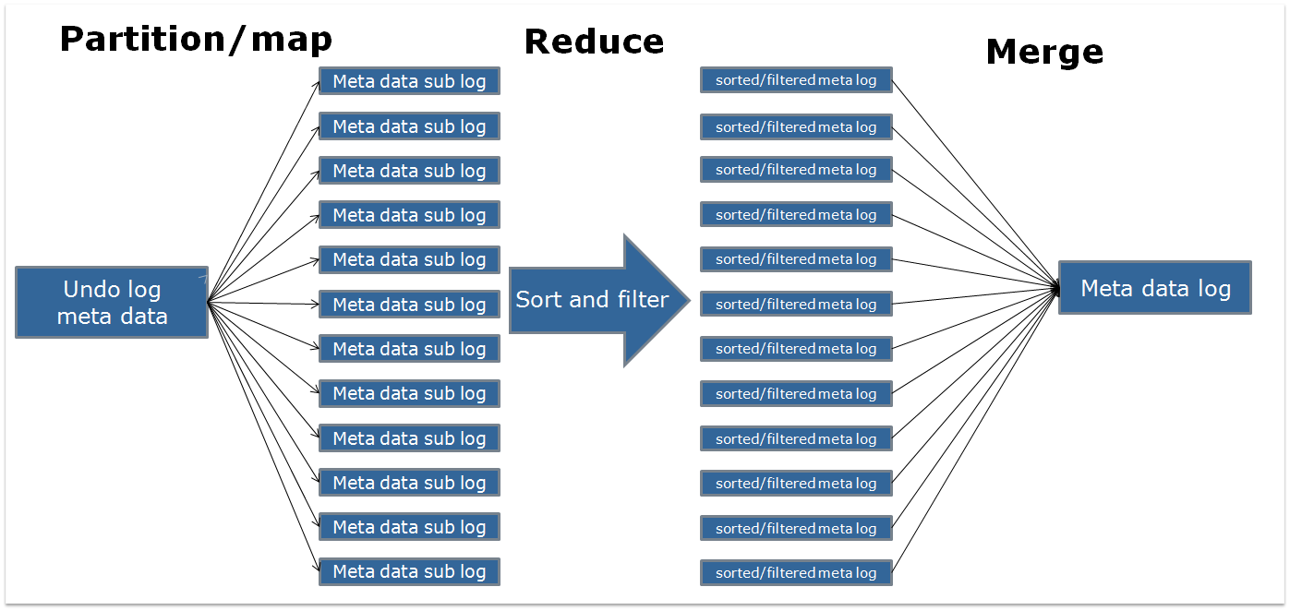
Partition/map
Reduce
Merge
Meta data sub log
sorted/filtered meta log
Meta data sub log
sorted/filtered meta log
Meta data sub log
sorted/filtered meta log
Meta data sub log
sorted/filtered meta log
Meta data sub log
sorted/filtered meta log
Undo log meta data
Meta data log
Meta data sub log
Sort and filter
sorted/filtered meta log
Meta data sub log
sorted/filtered meta log
Meta data sub log
sorted/filtered meta log
Meta data sub log
sorted/filtered meta log
Meta data sub log
sorted/filtered meta log
Meta data sub log
sorted/filtered meta log
Meta data sub log
sorted/filtered meta log

Slide 16
Accessing the data structure
The data structure as a cache table holding for each offset in the volume an offset to an offset table of pointers.
A stream of pointers each pointer holding offset in the undo log and an offset in the volume matching the undo volume.

Slide 17
Access table
Offset0
Offset1
Offset2
Meta data log device
Undo log
Partition/map
Reduce
Merge
Meta data sub log
sorted/filtered meta log
Meta data sub log
sorted/filtered meta log
Meta data sub log
sorted/filtered meta log
Meta data sub log
sorted/filtered meta log
Meta data sub log
sorted/filtered meta log
Undo log meta data
Meta data log
Meta data sub log
Sort and filter
sorted/filtered meta log
Meta data sub log
sorted/filtered meta log
Meta data sub log
sorted/filtered meta log
Meta data sub log
sorted/filtered meta log
Meta data sub log
sorted/filtered meta log
Meta data sub log
sorted/filtered meta log
Meta data sub log
sorted/filtered meta log

Slide 18
Performance analysis
Partition/map
Reduce
Merge
Meta data sub log
sorted/filtered meta log
Meta data sub log
sorted/filtered meta log
Meta data sub log
sorted/filtered meta log
Meta data sub log
sorted/filtered meta log
Meta data sub log
sorted/filtered meta log
Undo log meta data
Meta data log
Meta data sub log
Sort and filter
sorted/filtered meta log
Meta data sub log
sorted/filtered meta log
Meta data sub log
sorted/filtered meta log
Meta data sub log
sorted/filtered meta log
Meta data sub log
sorted/filtered meta log
Meta data sub log
sorted/filtered meta log
Meta data sub log
sorted/filtered meta log

Slide 19
Testing Environment
RecoverPoint GEN4 data protection appliances, 8192MB of RAM, 2 quad core CPU , QLogic QLE2564 quad-port PCIe-to-8Gbps Fibre Channel Adapter.
CLARiiON CX4-480 storage array , 30 Fibre Channel attached disks, 6 separate RAID5, 4+1 RAID groups.
1 consistency group replicating 12 volume on 4 separate RAID5 4+1 groups, 3 volumes per raid group.
The journal was striped over over two separate RAID groups.

Slide 21
Customer Data
We collected data from over 500 customer applications from 20 different customers from multiple industries.
The data was collected only for replicated applications, and includes write statistics at per second granularity.
We also included special graphs for the 5 top performance applications.

Slide 22
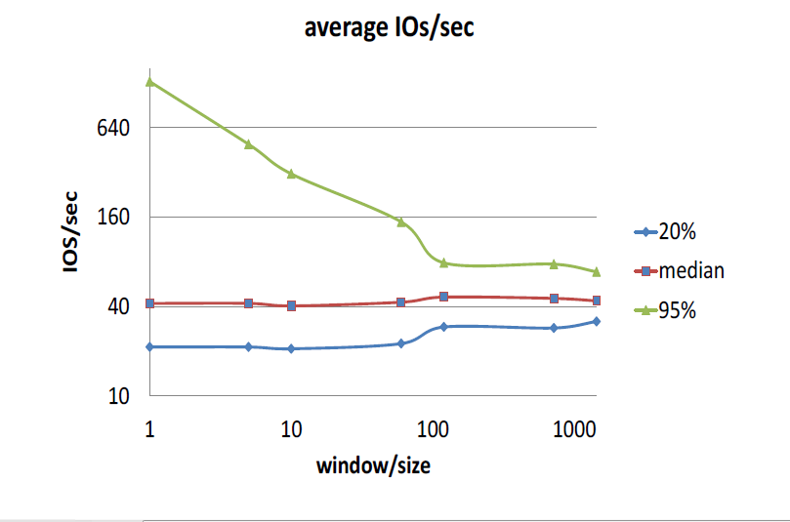

Slide 23
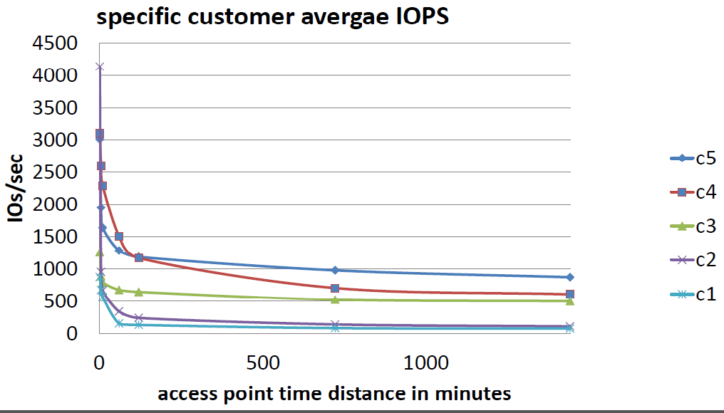

Slide 24
