Slide 1
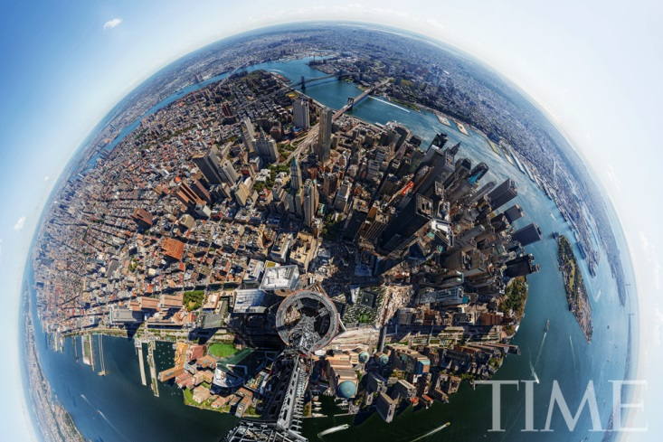
Generating panorama using translational movement model

Slide 2
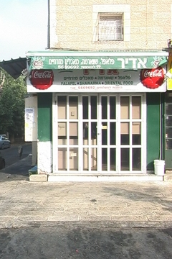
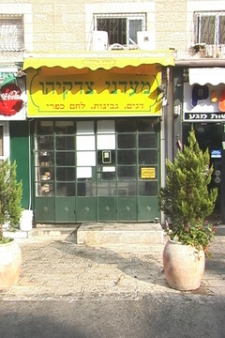
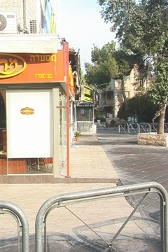
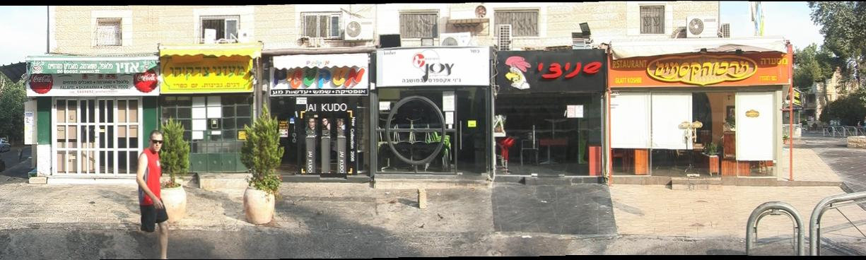
Algorithms for stitching images into seamless photo-mosaics are among the oldest and most widely used in computer vision. Image stitching algorithms create the high-resolution photo-mosaics used to produce today’s digital maps and satellite photos.

Slide 3
Before we can register and align images, we need to establish the mathematical relationships that map pixel coordinates from one image to another. A variety of such parametric motion models are possible, from simple 2D transforms, to planar perspective models, 3D camera rotations, lens distortions, and mapping to non-planar (e.g., cylindrical) surfaces.
translation
affine
perspective
3D rotation
In this work we assume a 2D translation between 2 consecutive images.

Slide 4
Computing Translation
Assumption: Constant Brightness
Given images I1 and I2, we can find the translation (u,v) that will minimize the squared error =
I₁
I₂
v
u

Slide 5
Brightness Constancy Equation
First order Taylor Expansion
Simplify notations:
Divide by dt and denote:

Slide 6
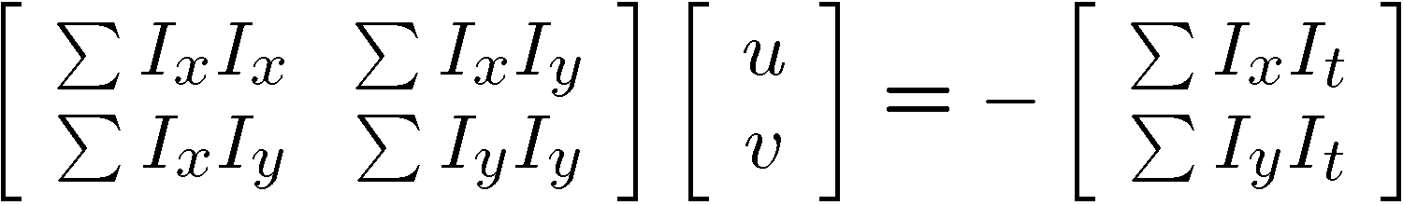


Lucas Kanade (1981)
Method: Least-Squares
Goal: Minimize

Slide 7
Drawback of the method
  Based on first order approximation, therefore works well only for small motion.
Iterative Lucas-Kanade Algorithm
  Estimate velocity solving Lucas-Kanade equations
  Warp I(t+1) towards I(t) using the estimated flow field
  Repeat until convergence

Slide 8
Multi-Scale Flow Estimation
u=1.25 pixels
u=2.5 pixels
u=5 pixels
u=10 pixels
image I_{t}
image I_{t-1}
image I_{t+1}
image I
Gaussian pyramid of image I_{t}
Gaussian pyramid of image I_{t+1}

Slide 9
Multi-Scale Flow Estimation
run Lucas-Kanade
warp & upsample
run Lucas-Kanade
.
.
.
image I_{t}
image I_{t-1}
image I_{t+1}
image I
Gaussian pyramid of image I_{t}
Gaussian pyramid of image I_{t+1}

Slide 10
Image Stabilization
We warp the input images to cancel the vertical and sub pixel horizontal components of the motion.
For example: If the motion between two successive images was u = 5.3 and v = 1.3, the motion between them after the warping will be u = 5 and v = 0.
I₁
I₂
I₁
I₂
v
u
u

Slide 11
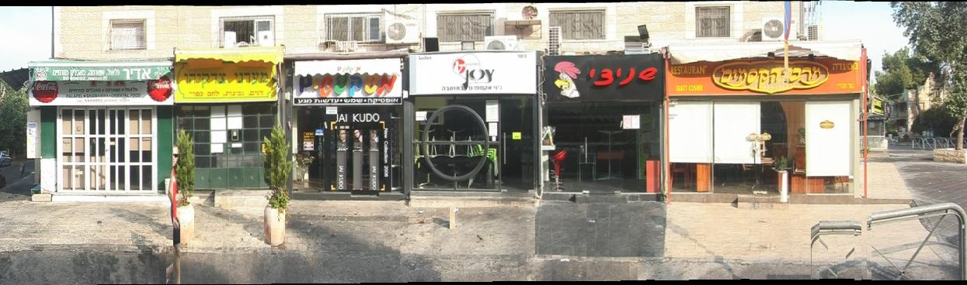
Image Stitching – Naïve Way
I₁
I₂
overlap

Slide 12
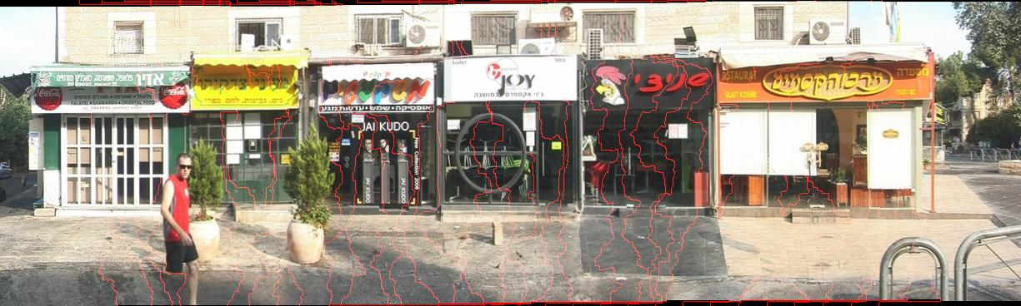
Image Stitching – Graph Cuts
W(u,v) =||A(u)-B(u)||² +||A(v)-B(v)||² +,where u,v are neighboring pixels in the overlap region.

Slide 13
References
B.D. Lucas and T. Kanade “An Iterative Image Registration Technique with an Application to Stereo Vision” IJCAI '81 pp. 674-679
S. Baker and I. Matthews “Lucas-Kanade 20 Years On: A Unifying Framework” IJCV, Vol. 56, No. 3, March, 2004, pp. 221 - 255.
Kwatra, V., Schödl, A., Essa, I., Turk, G., & Bobick “Graphcut Textures: Image and Video Synthesis Using Graph Cuts” In ACM Transactions on Graphics (ToG) (Vol. 22, No. 3, pp. 277-286). ACM.
Szeliski, Richard. “Graphcut Textures: Image and Video Synthesis Using Graph Cuts”. Springer, 2010.‏

