Slide 1
OCR of Math Expressions
BGU - Computational Vision Course
February, 2011
Optical Character Recognition
of
Mathematical Expressions
Presented By:
Dahan Yakir
Sepetnitsky Vitali
http://www.cs.bgu.ac.il/~ben-shahar/Teaching/Computational-Vision/StudentProjects/ICBV111/ICBV-2011-1-VitaliSepetnitsky-YakirDahan/index.php

Slide 2
Introduction

Slide 3
Motivation
The will to explore mathematical expressions given as a printed or captured image
It would be nice to have the ability to get a fast analysis of an expression according to some computational engine, by capturing its image with a mobile phone

Slide 4
Our Solution
A combination of image processing and computer vision:
Taking a mathematical expression given as an image
Performing an image processing and converting the image to B&W
Performing an OCR and retrieving the characters and mathematical symbols
Performing further analysis process and retrieving the full expression
Sending to Wolfram Alpha computational engine and obtaining the final result

Slide 5
Useful for
People working with mathematical expressions, especially students
Finding errors and inconsistencies in a typed mathematical expression
Rewriting and redesigning a typed expression
Transferring the expression between different applications and text files
Getting visual graphs of functions

Slide 6
OCR: Optical Character Recognition
Allows a machine to recognize characters through an optical mechanism
Refers to all technologies which perform translation of scanned/captured images of text to a machine-encoded text with the same interpretation
After performing OCR, a further processing can be applied to the text, such as text-to-speech
A field of research in computer vision and artificial intelligence.

Slide 7
Ways to perform OCR
There are several ways to perform OCR:
Measuring some features of the given image and establishing a similarity measure against pre-saved set of templates
Contextual or grammatical information can be used to feedback the OCR and increase the accuracy of the process
Artificial intelligence methods such as Artificial Neural Networks can be employed

Slide 8
Our Approach and Method 4 Stages

Slide 9
Stage 1: Image Processing
Converting the image to gray scale
Converting the gray-scaled image to B&W
Removing all connected groups of pixels with less than 9 pixels - reducing noises
Cropping the result image to make its size be the size of its minimal bounding rectangle - retaining the expression only and omitting the redundant background

Slide 10
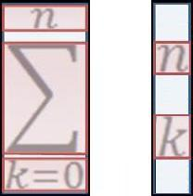
Stage 2: Division to Single Chars
Left-to-right, Top-to-bottom order is assumed
Order Inaccuracies are repaired during the further processing step

Slide 11
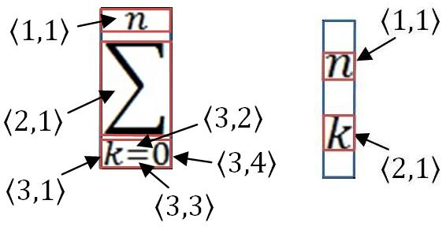
Stage 2 (Cont.)
The final result of this step is a division of the image into clumps.
Each clump is assumed to represent a single character or mathematical symbol

Slide 12
Stage 3: OCR of a Single Char
A pre-saved set of templates is used
A 2-D correlation coefficient is calculated by the following formula:
The interpretation is given according to the template which maximizes the coefficient

Slide 13
Stage 4: Further Processing
The result of the stages 1-3 was called a “pseudo-result”
the final result is retrieved after performing a conversion of the pseudo-result to a mathematical expression, using syntactic clues of expressions of this type
Example:
For the image on the right:
Pseudo result is: “n : sum : k -- 0 : ( n k )”
After processing we get: “sum(C(n, k), k = 0 to n)”

Slide 14
The Application

Slide 15
Application Features
Two ways for loading images:
Loading an image from a pre-saved file
Capturing an image from a
web-camera
OCR using MATLAB
GUI using Sun’s Swing Toolkit (Java)
Connection with MATLAB using JAMAL

Slide 16
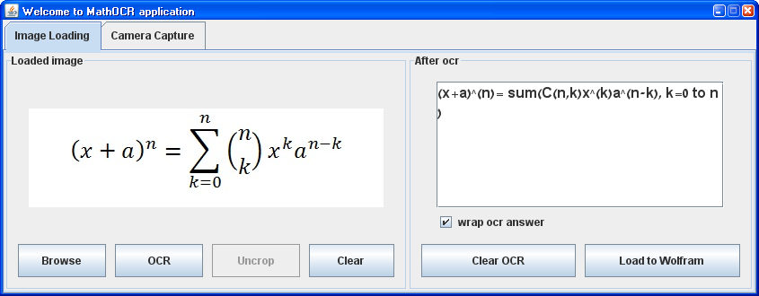
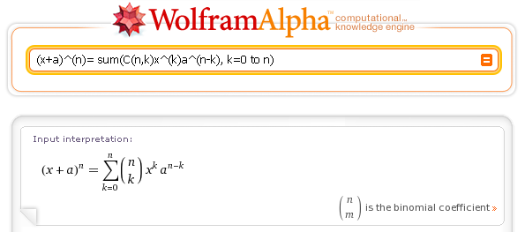
A Few Screenshots …

Slide 17
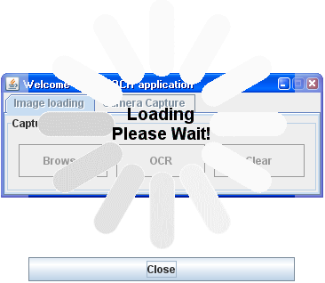
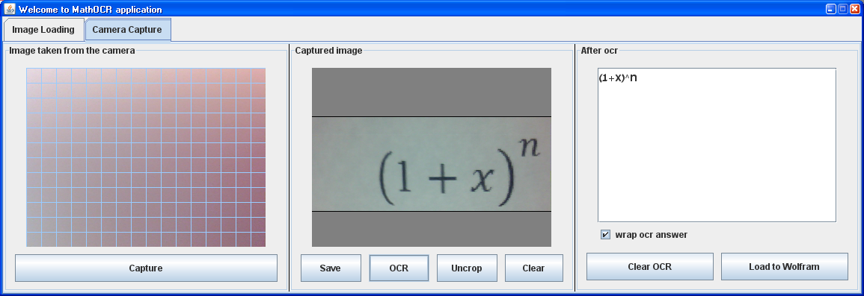
A Few Screenshots … (Cont.)

Slide 18
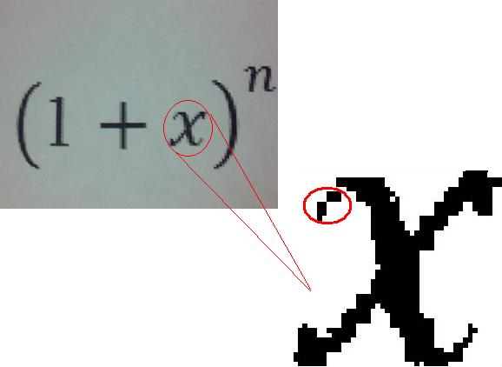
Results
Tested on a dataset of 20 images of mathematical expressions with different levels of complexity
Total accuracy close to 95%
A high sensitivity to little errors in the image caused by insufficient quality of the captured image

Slide 19
Results (Cont.)
A very high sensitivity to rotation of the expression appearing in the image (the “orientation” of the expression)
The total accuracy decreases drastically as the expression is rotated from the horizontal position
60% accuracy!
100% accuracy!
cx + a) ^ h !! sum(ckn, k=0 to n) x ^ (k) a ^ (n!k
(x + a) ^ n = sum(C(n, k)x ^ (k) a ^ (n – k), k=0 to n)

Slide 20
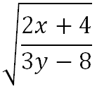
Conclusions and Future Work
The application can be considered as a prototype of more extensive and complicated application with more capabilities and features
The process of performing OCR to a single character can be changed to a more sophisticated method capable to deal with more fonts
A recursive process can be implemented in order to deal with single lines (like )

Slide 21
ANY Questions
?
Thank You!

