Slide 1
Student Seminar – Fall 2012
A Simple Algorithm for Finding Frequent Elements in Streams and Bags
RICHARD M. KARP, SCOTT SHENKER
and
CHRISTOS H. PAPADIMITRIOU
2003

Slide 2
Overview
Introduction
Agenda
Pass 1
Pass 1 implementation
Pass 2
Summary

Slide 3
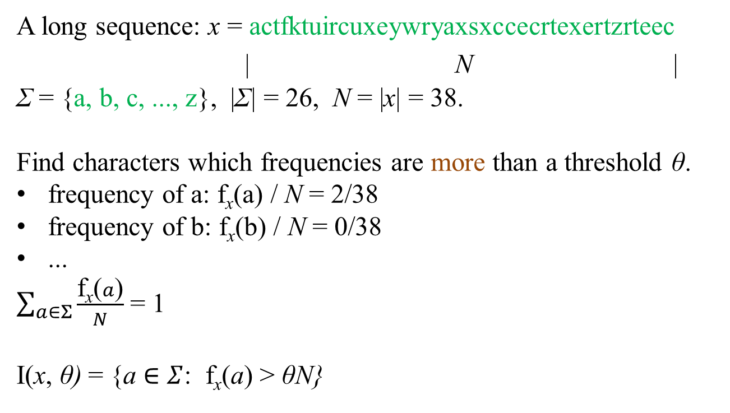
Introduction
A long sequence: x = actfktuircuxeywryaxsxccecrtexertzrteec
| N |
Σ = {a, b, c, ..., z}, |Σ| = 26, N = |x| = 38.
Find characters which frequencies are more than a threshold θ.
frequency of a: f_{x}(a) / N = 2/38
frequency of b: f_{x}(b) / N = 0/38
...
$\sum_{a∈Σ}{\frac{\text{f}\text{x}\text{(}a\text{)}}{N}}$ = 1
I(x, θ) = {a $∈$ $Σ$: f_{x}(a) > θN}

Slide 4
Motivation
Network congestion monitoring.
Data mining.
Analysis of web query logs.
...
Finding high frequency elements in a multiset, so called “Iceberg query”, or “Hot list analysis”.

Slide 5
On-line vs. off-line
On-line algorithm is one that can work without saving all the input. It is able to treat each input element at arrival (stream oriented).
In contrast, off-line algorithm needs a place to save all the input (bag oriented).

Slide 6
Performance
Because of huge amount of data it is really important to reduce the time and space demands.
Preferable on-line analysis – one pass.
Performance criteria:
Amortized time (time for a sequence divided by its length).
Worst case time (on-line only, time for symbol occurrence, maximized over all occurrences in the sequence).
Number of passes.
Space.

Slide 7
Passes
If we can’t be satisfied in one on-line pass, we’ll use more. But in many problems, there should be minimal passes number. We still will not save all the input.
For example, the Finding Frequent Elements problem on whole hard disk. To save the time it will be much better to make each algorithm pass using single reading head route an all the disk.

Slide 8
Problem Definitions
Given:
x = (x₁, ... x_{N}) $∈Σ$* – an input sequence
N = |x| – this sequence length
$Σ$ – an alphabet with n symbols (|$Σ$| = n)
f_{x}(a) – the number of occurrences of a in the sequence x
θ – a threshold (real number between 0 and 1)
Assumption:
N >> n >> 1/ θ
Needed: I(x, θ)$⊆Σ$ – a set of characters with frequency more than θ in sequence x.

Slide 9
History
N.Alon, Y.Matias, and M.Szegedy (1996) proposed an algorithm which calculates a few highest frequencies without identifying the corresponding characters in one pass on-line.
Attempts to find the forth or further highest frequencies need dramatically growing time and space and become not profitable.

Slide 10
Overview
Introduction
Agenda
Pass 1
Pass 1 implementation
Pass 2
Summary

Slide 11
Space bounds
Proposition 1. |I(x, θ)| ≤ 1/θ.
Indeed, otherwise there are more than 1/θ * θN = N occurrences of all symbols from I(x, θ) in the sequence.
Proposition 2. The on-line algorithm, which uses O(n) memory words is straightforward – just saving counters for each alphabet character.
Theorem 3: Any one pass on-line algorithm needs in the worst case Ω(nlog(N / n)) bits.
The proof will come later.

Slide 12
Algorithm specifications
So we’ll need much more than 1/θ space for on-line one pass algorithm.
We’ll present an algorithm, which:
Uses O(1/θ) space.
Makes two passes.
O(1) per symbol occurrence runtime, including worst case.
The first pass will create a superset K of I(x, θ), |K| ≤ 1/θ, with possible false positives.
The second pass will find I(x, θ).

Slide 13
Overview
Introduction
Agenda
Pass 1
Pass 1 implementation
Pass 2
Summary

Slide 14
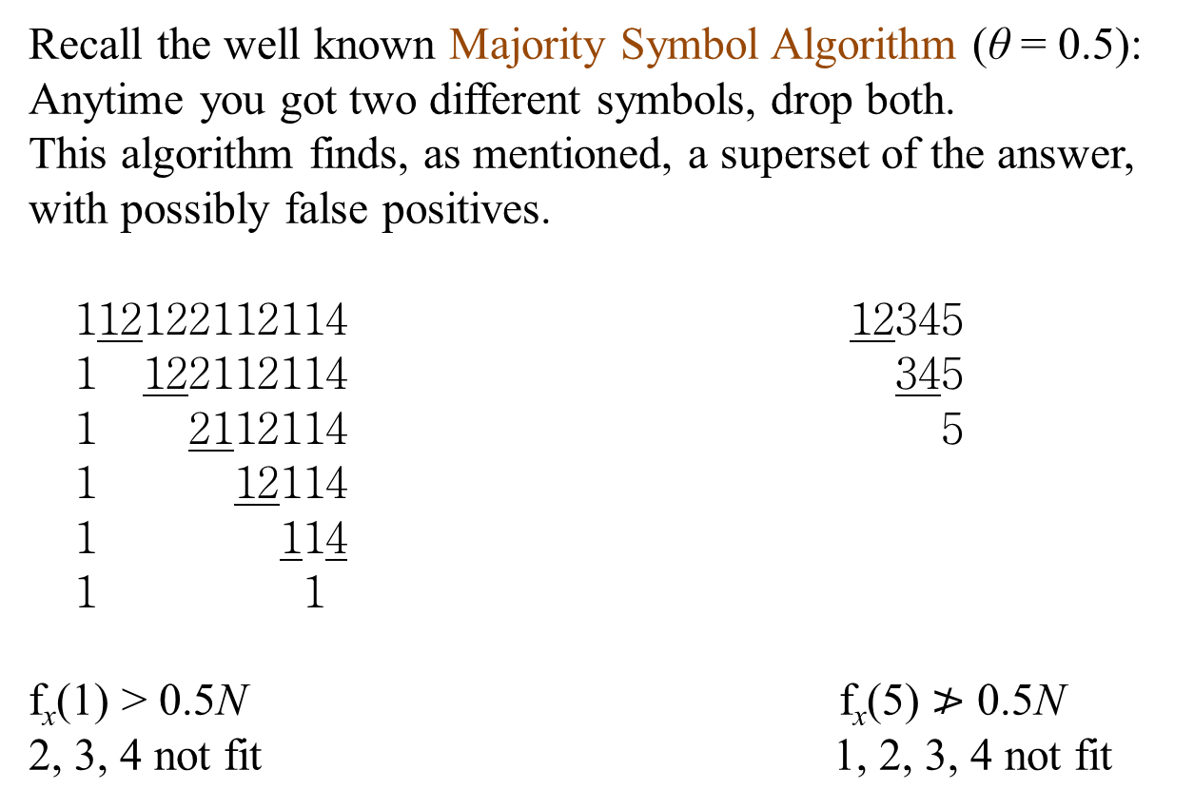
Pass 1 – Algorithm Description
Recall the well known Majority Symbol Algorithm (θ = 0.5):
Anytime you got two different symbols, drop both.
This algorithm finds, as mentioned, a superset of the answer,
with possibly false positives.
112122112114 12345
1 122112114 345
1 2112114 5
1 12114
1 114
1 1
f_{x}(1) > 0.5N f_{x}(5) $≯$ 0.5N
2, 3, 4 not fit 1, 2, 3, 4 not fit

Slide 15
Pass 1 – the code
Generalizing on θ:
x[1] ... x[N] is the input sequence
K is a set of symbols initially empty
count[] is an array of integers indexed by K
for i := 1, ..., N do
{if (x[i] is in K) then count[x[i]] := count[x[i]] + 1
else {insert x[i] in K
set count[x[i]] := 1}
if (|K| > 1/theta) then
for all a in K do
{count[a] := count[a] – 1
if (count[a] = 0) then delete a from K}}
output K

Slide 16
Pass 1 – example
count | K | x
 | {}
a(1) | {a} | a
a(2) | {a} | a
a(2), b(1) | {a, b} | b
a(2), b(1), c(1) | {a, b, c} | c
a(1) | {a}
a(1), b(1) | {a, b} | b
a(2), b(1) | {a, b} | a
a(3), b(1) | {a, b} | a
a(3), b(1), d(1) | {a, b, d} | d
a(2) | {a}
a(2), c(1) | {a, c} | c
a(2), c(2) | {a, c} | c
a(2), c(2), d(1) | {a, c, d} | d
a(1), c(1) | {a, c}
x = aabcbaadccd
θ = 0.35
N = 11
θN = 3.85
f_{x}(a) = 4 > θN
f_{x}(b) = f_{x}(d) = 2 < θN
f_{x}(c) = 3 < θN
1/θ ≈ 2.85
|K|≥3
Result: a (+), c (–)

Slide 17
Pass 1 – proof
Theorem 4: The algorithm computes a superset K of I(x, θ) with |K| ≤ 1/θ, using O(1/θ) memory and O(1) operations (including hashing operations) per occurrence in the worst case.
Proof:
Correctness by contradiction: Let’s assume there are more than θN occurrences of some a in x, and a is not in K now.
So we removed these occurrences, but each time 1/θ occurrences were removed. So totally we removed more than θN * 1/θ = N symbols, but there are only N, a contradiction.
|K| ≤ 1/θ from algorithm description.
So, we need O(1/θ) space.
For O(1) runtime let’s see the implementation.

Slide 18
Overview
Introduction
Agenda
Pass 1
Pass 1 implementation
Pass 2
Summary

Slide 19
Hash
Hash table maps keys to their associated values.
Our collision treat: Chaining hash – each slot of the bucket array is a pointer to a double linked list that contains the elements that hashed to the same location.
For example,
hash function f(x) = x mod 5.
0
15
1
2
12
2
97
3
3
88
4

Slide 20
Pass 1 implementation – try 1
K as hash; needs O(1/θ) memory.
There are O(1) amortized operations per occurrence arrival: Constant number of operations per arrival without deletions; each deletion is charged by the token from its arrival.
But: Not enough for the worst case bound.
Conclusion: We need a more sophisticated data structure.

Slide 21
Pass 1 – implementation demands
We have now a problem of Data Structures theory.
We need to maintain:
A set K.
A count for each member of K.
And to support:
Increment by one the count of a given K member.
Decrement by one the counts of all elements in the K, together with erasing all 0-count members.

Slide 22
Pass 1 – implementation
K as hash remains as is.
New linked list L. It’s p^{th} link is a pointer to a double linked list l_{p} of members of K that have count p.
A double pointer from each element of l_{p} to the corresponding hash element.
A pointer from each element of l_{p} to it’s “counter in L”.
Deletions will be done by special garbage collector.
K = {a, c, d, g, h},
cnt(a)=4,
cnt(c)=cnt(d)=1,
cnt(g)=3,
cnt(h)=1
L
X
K
c
g
a
d
...
h
h

Slide 23
Pass 1 – time
Any symbol occurrence needs:
O(1) time for hash operations.
Constant number of operations:
to insert as first element of l₁
to find proper “counter copy” and move it from l_{p} to l_{p+1}
to create new “counter” at the end of L
to move the start of L forward.
The deletions fit because of garbage collector usage, each time constant operations number.
L
K
c
g
a
...
h
d
h

Slide 24
Pass 1 – last try
Fits time properly.
But ... space is O(1/θ + c), where c is length of L.
Bad for, e.g., x = a^{N}, so we need a small improvement:
Empty elements of L are absent, each non-empty one has the length field to the preceding neighbor, which still needs O(1) time.
So the maximal length of L is 1/θ, same as the size bound of K.
Thus, needed space is O(1/θ) in the worst case.
L
₍₁₎
₍₂₎
₍₁₎
₍₃₎
c
g
g
K
a
d
a
...
h
h

Slide 25
Overview
Introduction
Agenda
Pass 1
Pass 1 implementation
Pass 2
Summary

Slide 26
Pass 2 – Algorithm description
We have a superset K, |K| ≤ 1/θ.
Pass 2 – calculate counters for the members of K only.
Return only those fitting f_{x}(a) > θN.

Slide 27
The proof
Theorem 3: Any one pass on-line algorithm needs in the worst case Ω(nlog(N / n)) bits, when N > 4n > 16 / θ.
(recall N >> n >> 1/ θ)
Proof: We’ll show an example that needs such a space.
Assume that at the middle of x no symbol still occurred θN times.
We need to remember at this moment counters state of each symbol. Otherwise, we can’t distinguish two cases for some symbol: One in I, other missing one occurrence (recall equivalence classes).

Slide 28
The proof – cont’d
It seems like we need to remember all the n counters. But there is something better: Let’s create a set of all combinations and number them. So we need to remember only the number of current combination. We’ll find a minimum size of this set P and to save the current number we need log|P| space.
Let’s derive the lower bound for |P|.

Slide 29
|P| Lower Bound
We have n integers between 0 and θN with the sum $\left\lfloor N/2\right\rfloor$.
Let’s build an example for our purposes.
We’ll take a sequence ordered by $Σ$, with $\left\lfloor N/2n\right\rfloor$ occurrences of each symbol.
| $\left\lfloor N/2\right\rfloor$ |
|aaaaaa|bbbbbb|cccccc| ... | ... |
We can shift each border independently by until $±(\left\lfloor \frac{N}{4n}\right\rfloor −1)$.
So, there are at least ${(2\left\lfloor N/4n\right\rfloor −\text{2}\text{+}\text{1}\text{)}}^{n−1}$ sequences in P (for each border, totally n–1, $\left\lfloor N/4n\right\rfloor −1$ options in any direction, and one else for no change).
Taking logarithms, the algorithm uses Ω(nlog(N / n)) bits of memory. □

Slide 30
Summary
So, there was a simple two-pass algorithm for finding frequent elements in streams.
?

