Slide 1
Backtrack Algorithm for Listing Spanning Trees
R. C. Read and R. E. Tarjan (1975)
Presented by Levit Vadim

Slide 2
Abstract
Describe and analyze backtrack algorithm for listing all spanning trees
Time requirement: polynomial in |V|, |E| and linear in |T|
Space requirement: linear in |V| and |E|
Where
  V number of vertices in graph
  E number of edges in graph
  T number of all spanning trees

Slide 3
Main difficulty
Total number of all sub-graphs is exponential in |E|, which may be much more than T
We want to visit only sub-graphs that can be extended to a spanning tree
To perform this task we will restrict the search process by avoiding visiting sub-graphs that cannot be extended to those we need
Otherwise, the time in waste might become much more than linear in T

Slide 4
Listing all sub-graphs
Suppose we want to list all sub-graphs G’=(V, E’) of a given graph G=(V, E)
e2
e4
e3
e1
e7
e5
e6

Slide 5
Search technique: Backtracking
Choose some order for elements
When we examine an element, we decide whether to include it into the current solution or not
After we decide whether to include the current element, we continue to the next element recursively

Slide 6
Examine edges
Examine e1
Then continue to e2 recursively
e1
include
not include
e2
e2
e4
e4
e3
e3
e1
e7
e7
e6
e5
e6
e5

Slide 7
Backtracking cont.
When we have made a decision for each element in original set (whether to include it or not), we will list the set we have constructed only if it meets the criteria (in our case spanning tree)
Whenever we have tried both including and excluding an element, we backtrack to the previous element, and change our decision and move forward again, if possible
We can demonstrate the process by a search tree

Slide 8
Search tree
e1
e2
…
e6
include
e7
include
not include
Check if the set must be listed

Slide 9
Search tree
e1
e2
e2
…
…
e6
e6
include
not include
…
e7
e7
e7
…
include
not include
Backtrack to the previous element
By continuing this process, we will explore entire search space

Slide 10
Listing spanning trees
We will use a backtrack algorithm to list all spanning trees
At each stage of process, there is the current sub-graph (PST – partial spanning tree)
Besides, there is the current graph (G), to choose edges from
Notes:
אלגוריתם של Feussner

Slide 11
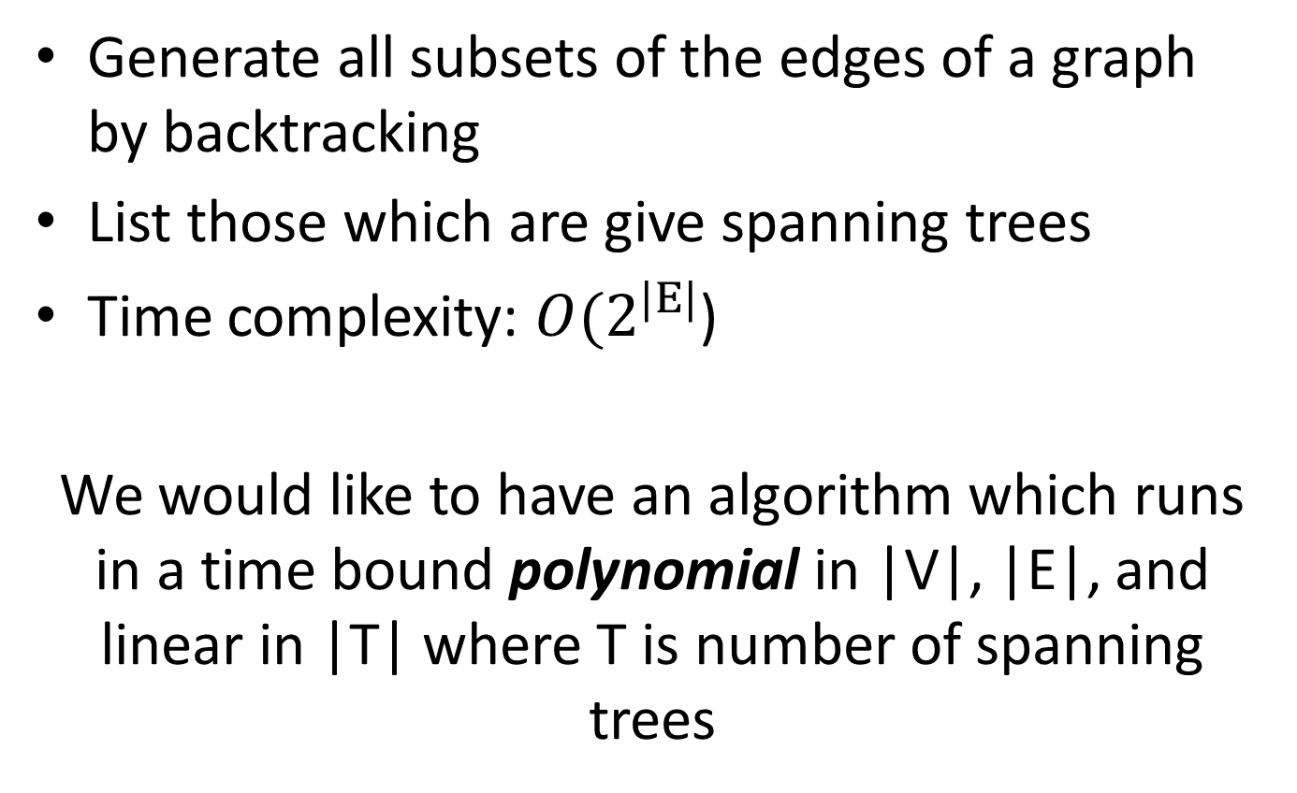
Naïve solution
Generate all subsets of the edges of a graph by backtracking
List those which are give spanning trees
Time complexity: $O(2^{|E|}$)
We would like to have an algorithm which runs in a time bound polynomial in |V|, |E|, and linear in |T| where T is number of spanning trees

Slide 12
Restricting backtracking
(“cutting the search tree”)
Main observations:
Any bridge of a graph must be included in all its spanning trees
Any edge which forms a cycle with edges already included in a partial spanning tree must be not included as an additional spanning tree edge

Slide 13
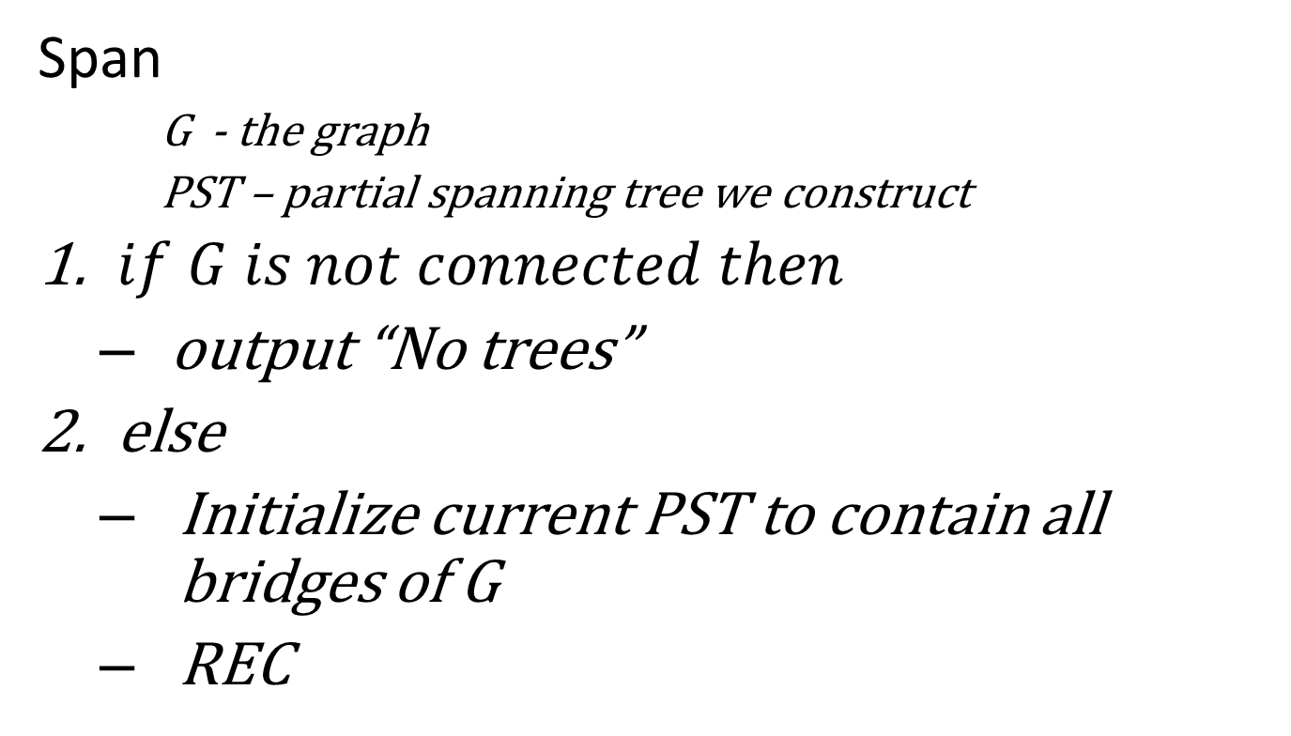
Span algorithm
Span
    G - the graph
    PST – partial spanning tree we construct
$if G is not connected then$
  output “No trees”
else
  Initialize current PST to contain all bridges of G
  REC

Slide 14

Procedure REC
(listing ST’s)
If $\left\{e | e∈G\right\}⊆\left\{e | e∈PST\right\} then$list PST
G
PST

Slide 15
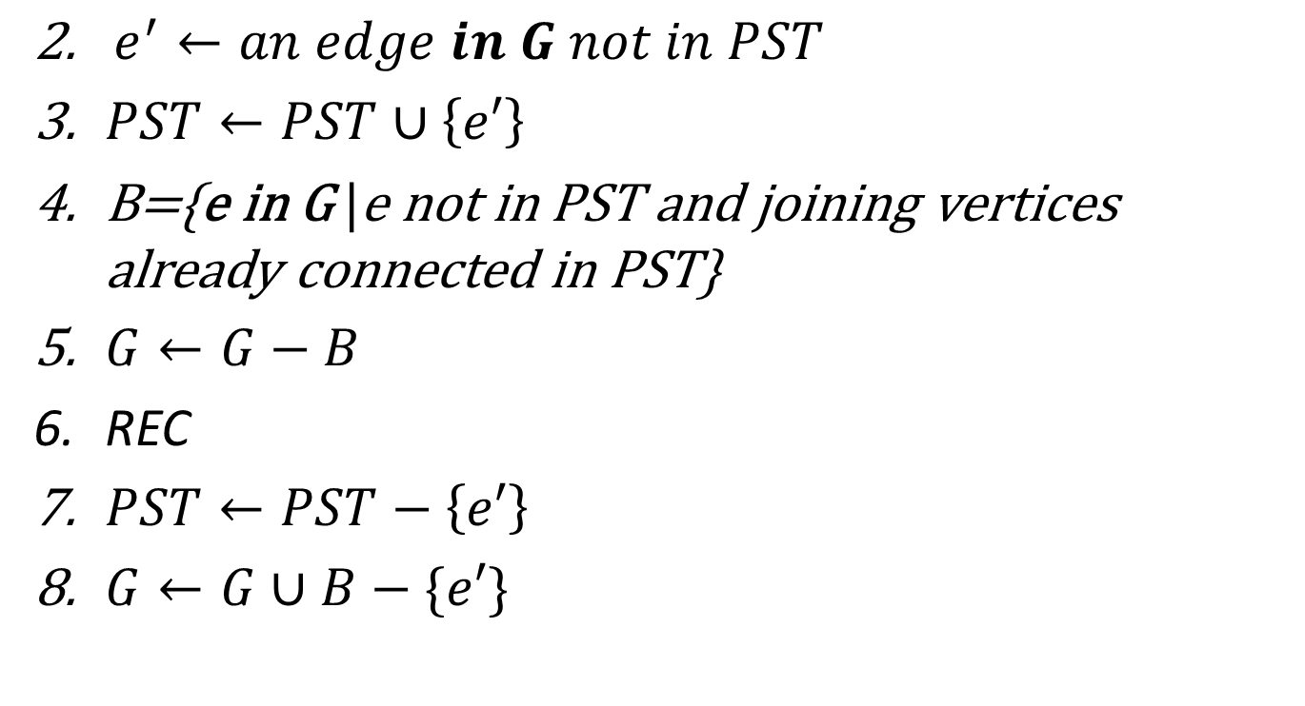
Procedure REC
(avoiding cycles – lines 3-6)
$e^{′}←an edge in G not in PST$
$PST←PST∪\left\{e′\right\}$
B={e in G |e not in PST and joining vertices already connected in PST}
$G←G−B$
REC
$PST←PST−\left\{e′\right\}$
$G←G∪B−\{e′\}$

Slide 16
Procedure REC
(avoiding cycles) cont.
G
PST
e'
The edges colored red form cycle in PST, so they must be stored at B and removed from G

Slide 17
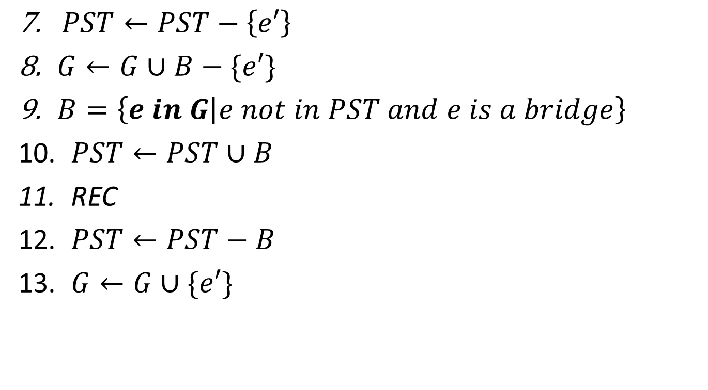
Procedure REC
(including bridges – lines 9-11)
$PST←PST−\left\{e′\right\}$
$G←G∪B−\{e′\}$
$B=\left\{e in G | e not in PST and e is a bridge\right\}$
$PST←PST∪B$
REC
$PST←PST−B$
$G←G∪\{e′\}$

Slide 18
Procedure REC
(including bridges) cont.
G
PST
e'
e'
Remove e’ from G and PST
Return to G all edges from B
Select all bridges

Slide 19
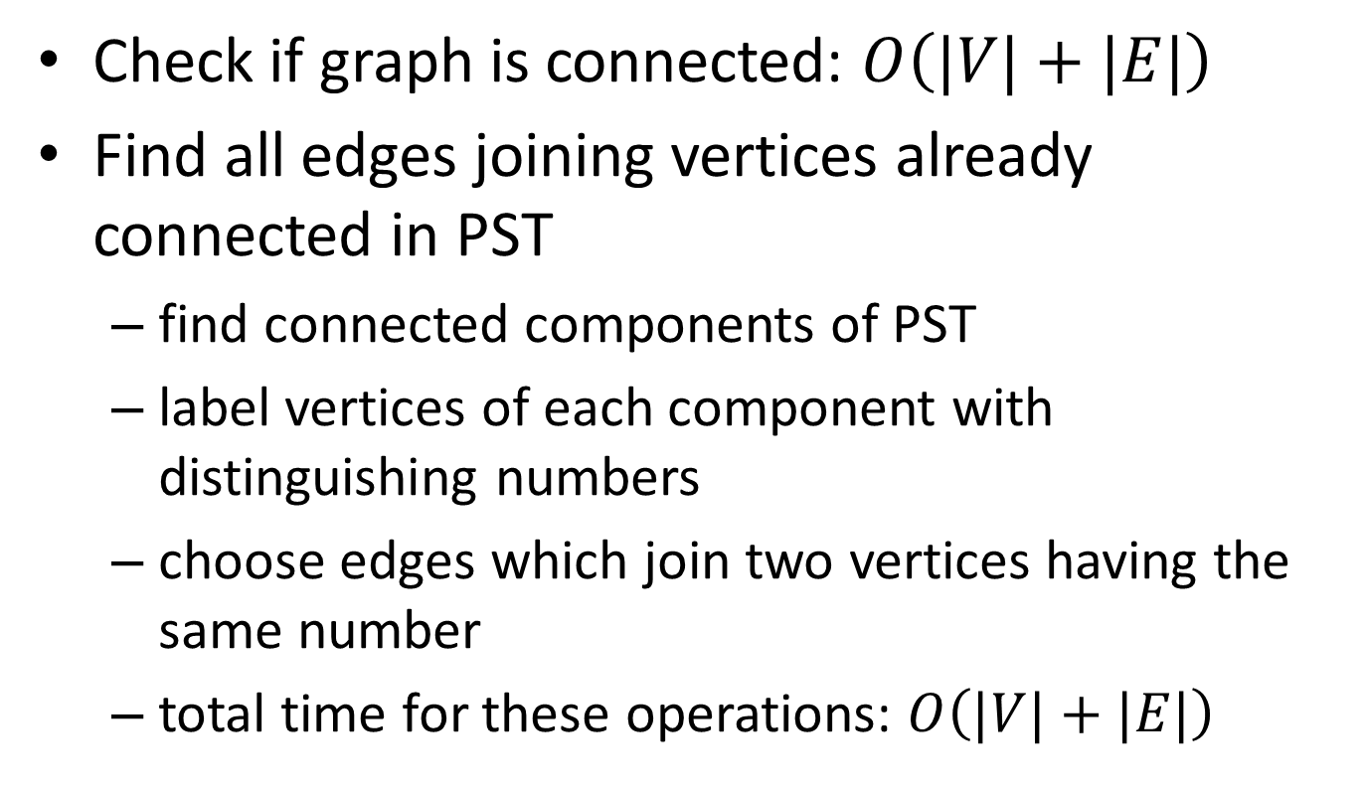
Time analysis
Check if graph is connected: $O\left(|V|+|E|\right)$
Find all edges joining vertices already connected in PST
  find connected components of PST
  label vertices of each component with distinguishing numbers
  choose edges which join two vertices having the same number
  total time for these operations: $O\left(|V|+|E|\right)$

Slide 20
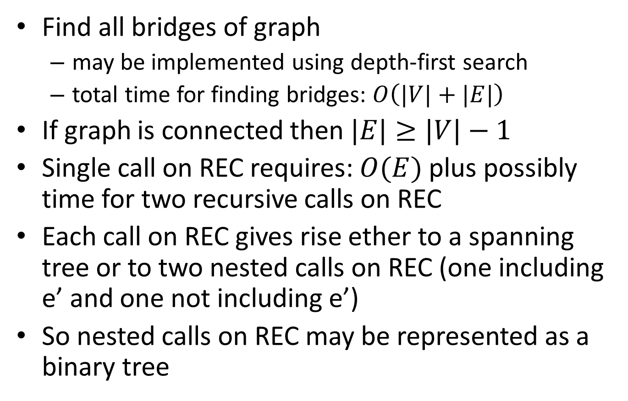
Time analysis cont.
Find all bridges of graph
  may be implemented using depth-first search
  total time for finding bridges: $O\left(|V|+|E|\right)$
If graph is connected then $|E|≥|V|−1$
Single call on REC requires: $O(E)$ plus possibly time for two recursive calls on REC
Each call on REC gives rise ether to a spanning tree or to two nested calls on REC (one including e’ and one not including e’)
So nested calls on REC may be represented as a binary tree

Slide 21
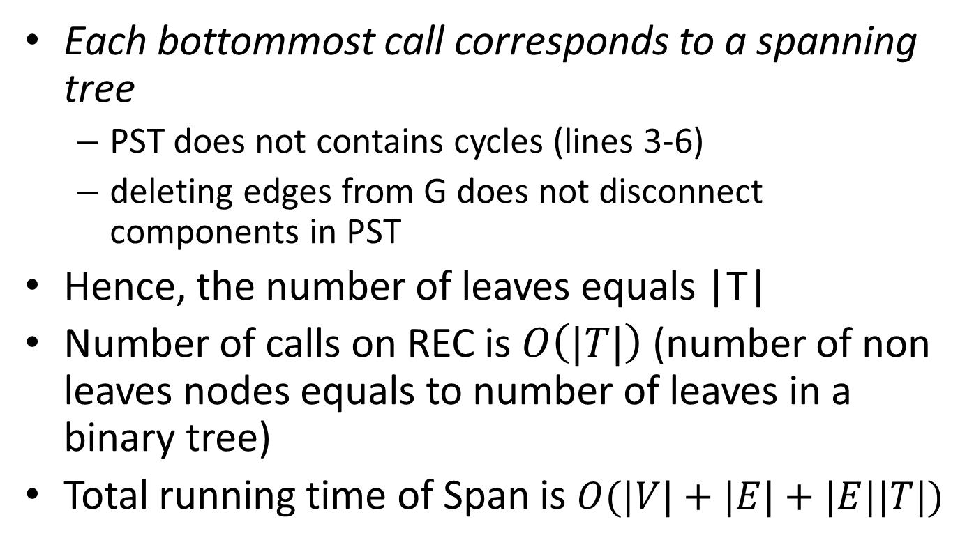
Time analysis
(recursive calls)
Each bottommost call corresponds to a spanning tree
  PST does not contains cycles (lines 3-6)
  deleting edges from G does not disconnect components in PST
Hence, the number of leaves equals |T|
Number of calls on REC is $O\left(|T|\right)$ (number of non leaves nodes equals to number of leaves in a binary tree)
Total running time of Span is $O(|V|+|E|+|E||T|)$

Slide 22
Space analysis
Any edge in B at some level of recursion is ether deleted from graph or included into partial spanning tree
  the edge in B is deleted from graph if it forms a cycle with edges in partial tree
  the edge in B is included into partial tree if it is a bridge

Slide 23
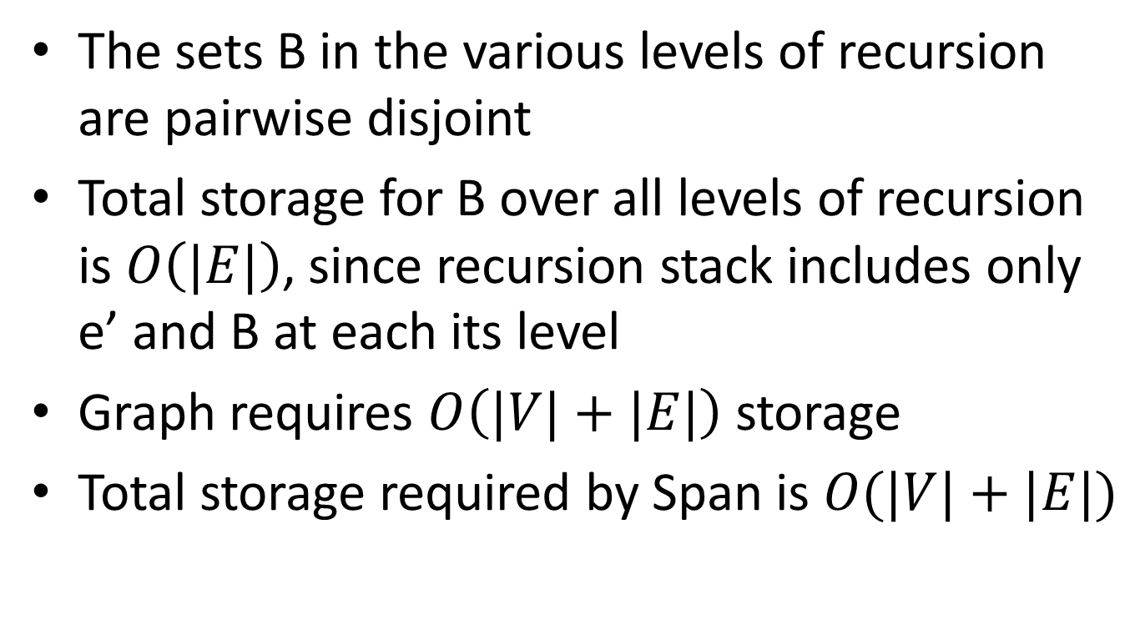
Space analysis cont.
The sets B in the various levels of recursion are pairwise disjoint
Total storage for B over all levels of recursion is $O\left(|E|\right)$, since recursion stack includes only e’ and B at each its level
Graph requires $O\left(|V|+|E|\right)$ storage
Total storage required by Span is $O(|V|+|E|)$

Slide 24
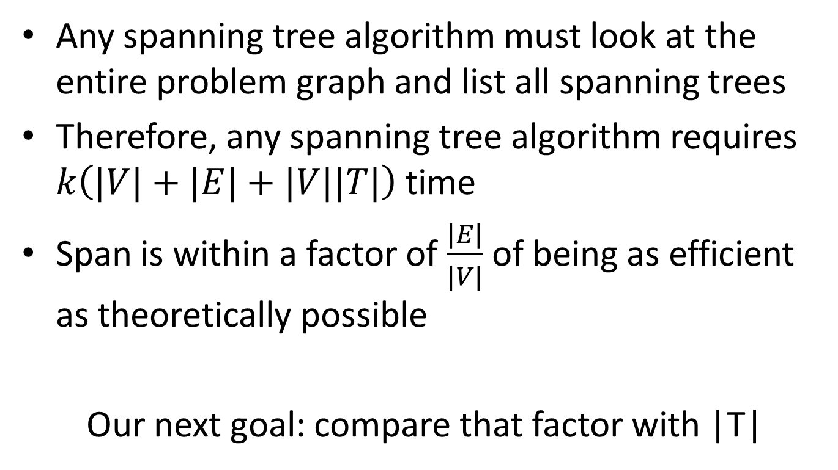
Theoretical time efficiency
Any spanning tree algorithm must look at the entire problem graph and list all spanning trees
Therefore, any spanning tree algorithm requires $k\left(|V|+|E|+|V||T|\right)$ time
Span is within a factor of $\frac{|E|}{|V|}$ of being as efficient as theoretically possible
Our next goal: compare that factor with |T|

Slide 25
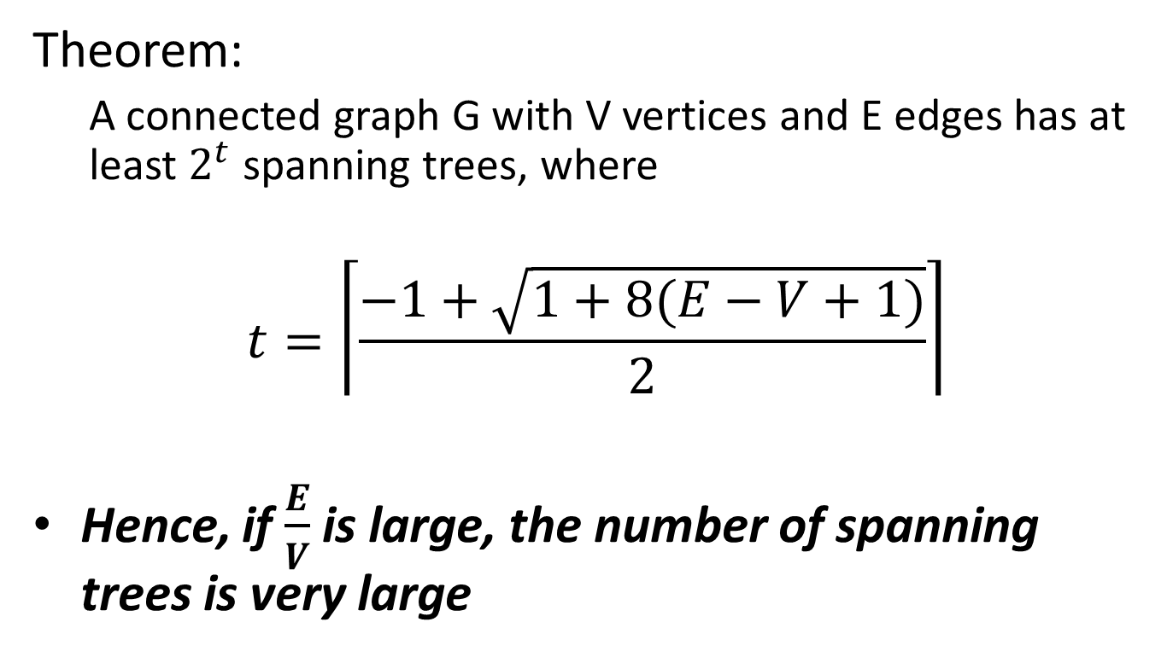
Number of spanning trees in graph
Theorem:
  A connected graph G with V vertices and E edges has at least $2^{t}$ spanning trees, where
$$t=\left\lceil \frac{−1+\sqrt{1+8(E−V+1)}}{2}\right\rceil$$
Hence, if $\frac{E}{V}$ is large, the number of spanning trees is very large

Slide 26
Proof
Pick any particular spanning tree J of G and delete all edges of J from G to form a graph G’
Let J’ be a graph consisting of trees, one spanning each connected component of G’
G and J
G’ and J’

Slide 27
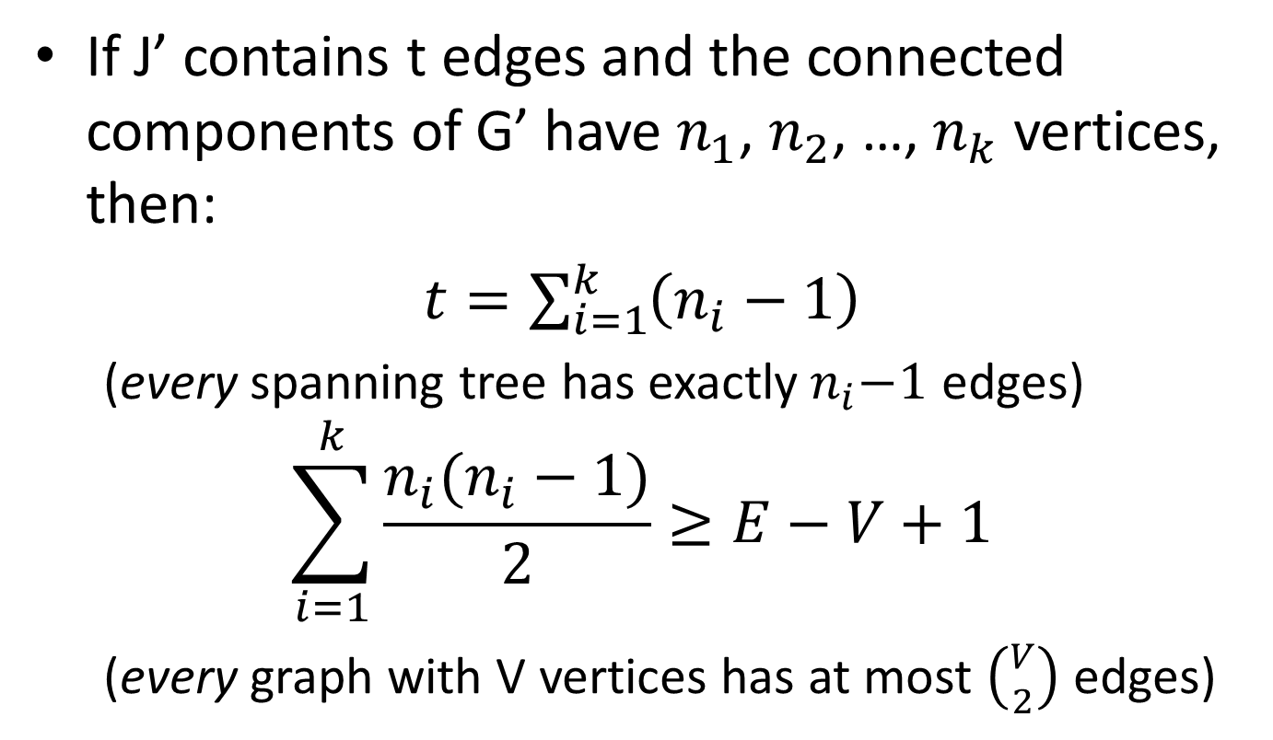
Proof cont.
If J’ contains t edges and the connected components of G’ have $n_{1}$, $n_{2}$, …, $n_{k}$ vertices, then:
$t=\sum_{i=1}^{k}{\left(n_{i}−1\right)}$
  (every spanning tree has exactly${ n}_{i}−1$ edges)
$$\sum_{i=1}^{k}{\frac{n_{i}(n_{i}−1)}{2}≥E−V+1}$$
  (every graph with V vertices has at most $\left({V \atop 2}\right)$ edges)

Slide 28
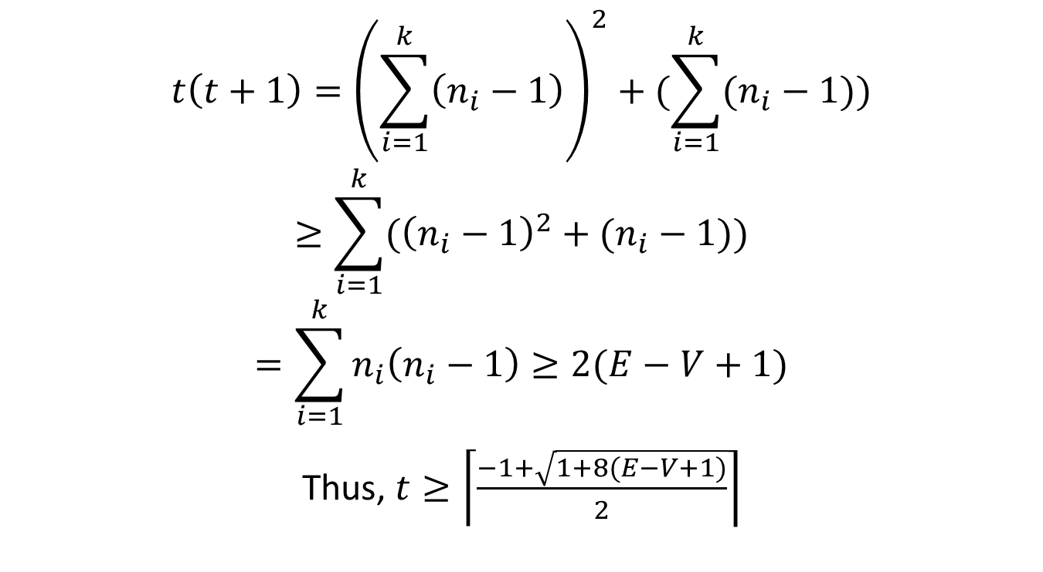
Proof cont.
$$t\left(t+1\right)={\left(\sum_{i=1}^{k}{\left(n_{i}−1\right)}\right)}^{2}+(\sum_{i=1}^{k}{(n_{i}−1)})$$
$$≥\sum_{i=1}^{k}{({\left(n_{i}−1\right)}^{2}+(n_{i}−1)})$$
$$=\sum_{i=1}^{k}{n_{i}\left(n_{i}−1\right)}≥2(E−V+1)$$
Thus, $t≥\left\lceil \frac{−1+\sqrt{1+8(E−V+1)}}{2}\right\rceil$

Slide 29
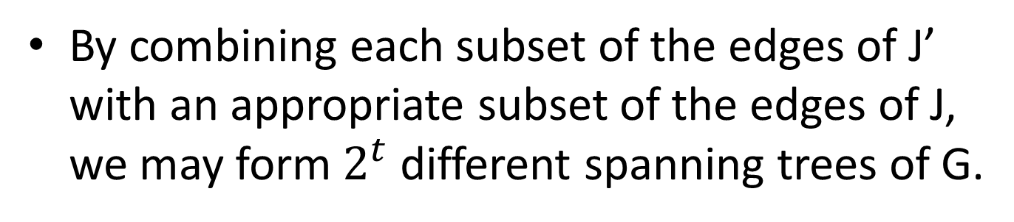
By combining each subset of the edges of J’ with an appropriate subset of the edges of J, we may form $2^{t}$ different spanning trees of G.
G and J
G’ and J’

