Slide 1
Auxiliary Application for Mammography system calibration and testing
Prepared by: Alex Shkatov
Professional advice and images:
Andrey Broisman, Ariel University Center of Samaria

Slide 2
Introduction
Mammography is the process of using low-energy-X-rays to examine the human breast.
The goal of mammography is the early detection of breast cancer
Over 300,000 mammography tests are performed every year in Israel.

Slide 3
Motivation
Image quality is critical
The system should be calibrated periodically
Simple image quality checks are made manually
Complex tests are not performed
Simple and free auxiliary tool is needed

Slide 4
ImageJ
Open source
Portable – Java based
Includes DICOM I/O libraries
Includes Vision algorithms libraries
Simple code integration via Plug-ins

Slide 5
Supported image quality tests
Contrast to Noise Ratio (CNR)
Detector ghosting (SDNR)
Modulation transfer function(MTF)

Slide 6
Contrast to Noise Ratio (CNR)

Slide 7
Contrast to Noise Ratio (CNR)

Slide 8
Contrast to Noise Ratio (CNR)

Slide 9
Detector ghosting (SDNR)

Slide 10
Detector ghosting (SDNR)

Slide 11
Detector ghosting (SDNR)

Slide 12
Modulation transfer function(MTF)

Slide 13
Modulation transfer function(MTF)

Slide 14
Modulation transfer function(MTF)

Slide 15
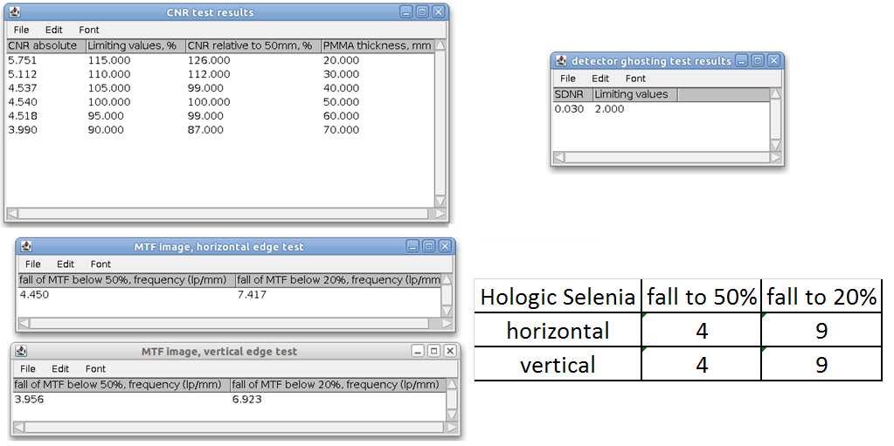
Results

Slide 16
Results - vertical edge

Slide 17
Results - horizontal edge

Slide 18
Conclusion
The results produced by the application are close to standard.
Additional images will be tested soon to verify the application.
Practical tests will be performed on mammography system computer.
Maybe someday the application will contribute to public health

