Slide 1
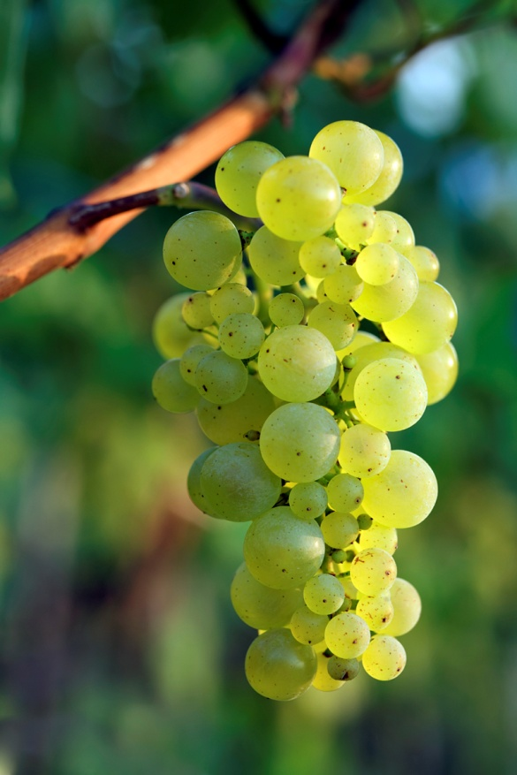
Detecting Grapes in Vineyard Images
How can we do it?
Sivan Radt

Slide 2
By what do we segment?
Color: Green
Shape: Circle
Texture: Smooth
Size: Relatively small
Special feature:
CLUSTERS

Slide 3
Basic Ideas
1. Naïve solution: Build a stock of grape images. Try each one of them on every part of the image.
2. Elimination: Remove all the pixels that can’t belong to a grape area.
3. Find small, green circles in clusters in the image.

Slide 4
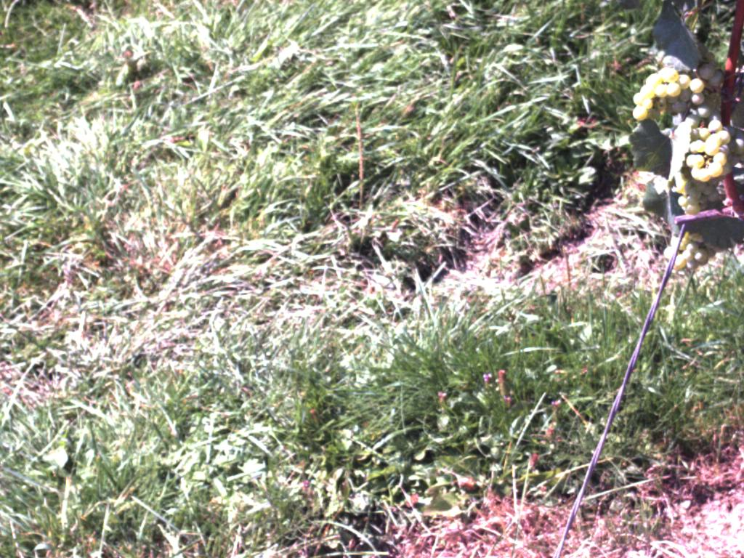
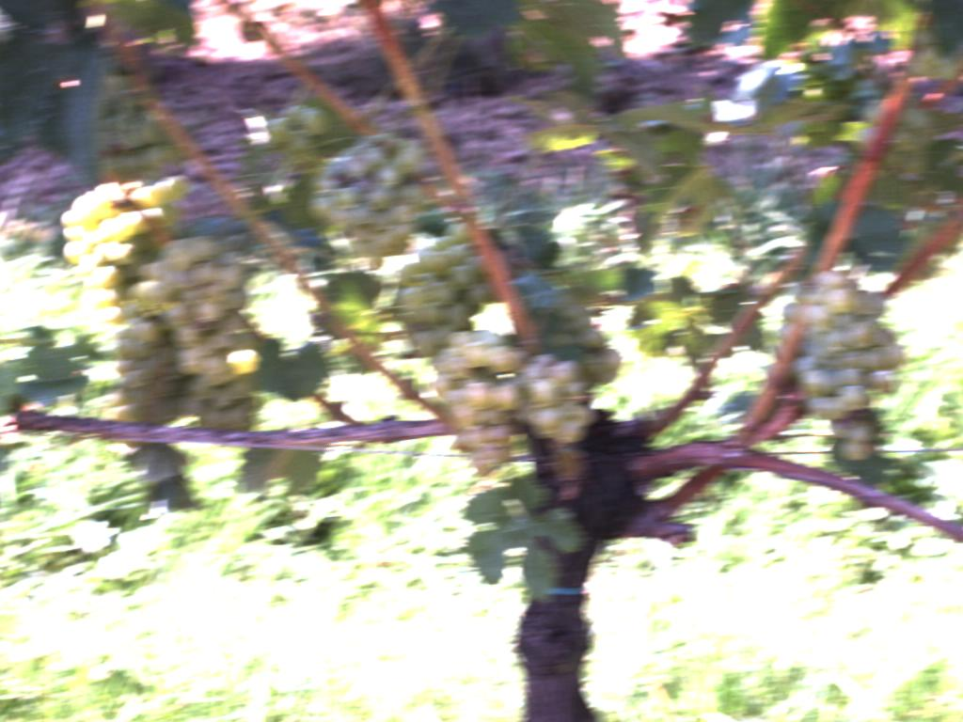
We can’t just look for circles…

Slide 5
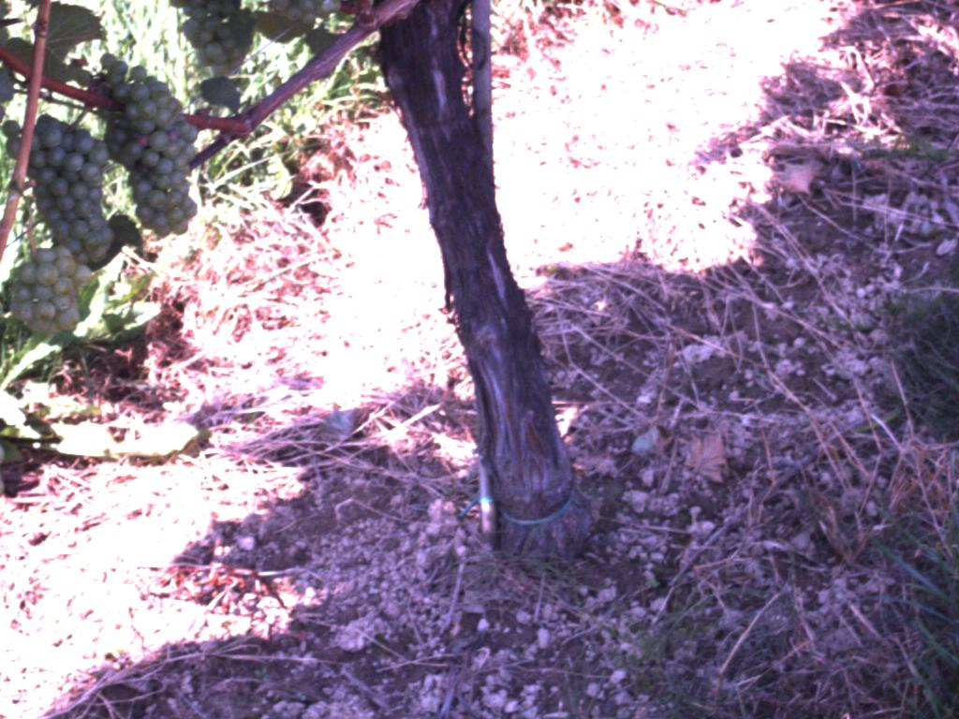
“refining” the image

Slide 6
Until you get…
Not!

Slide 7
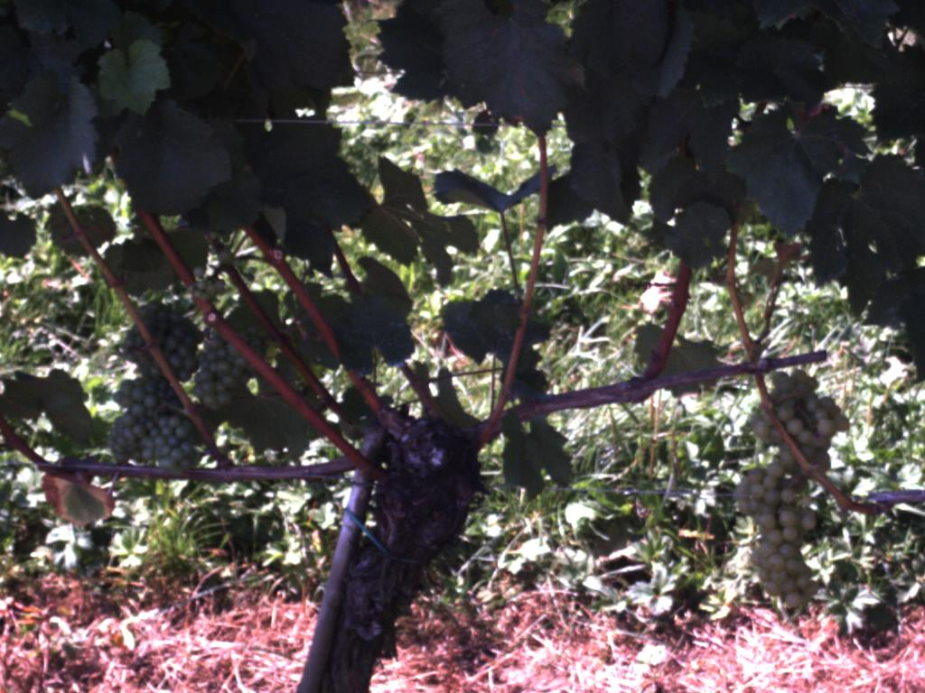
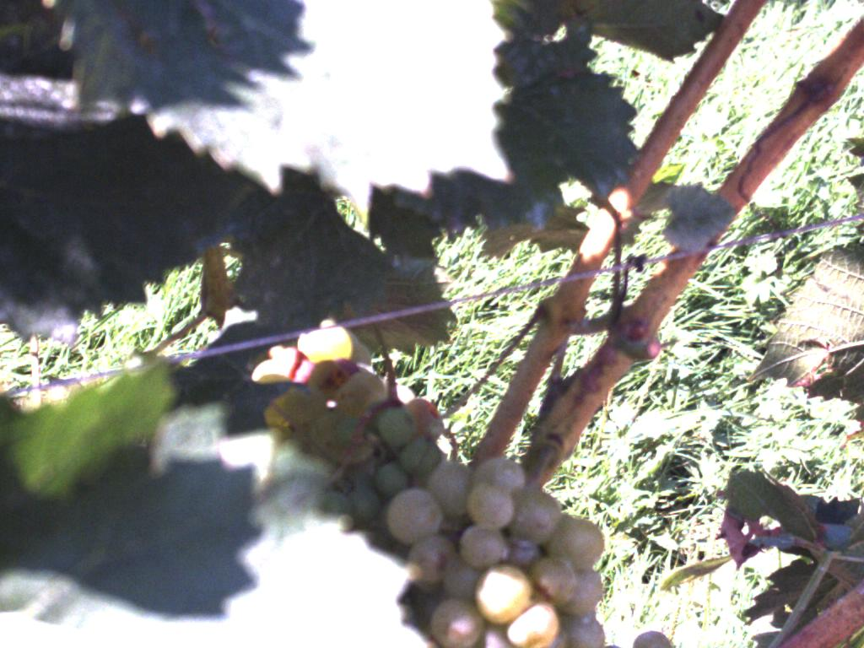
Why it will never work
Size of circles

Slide 8
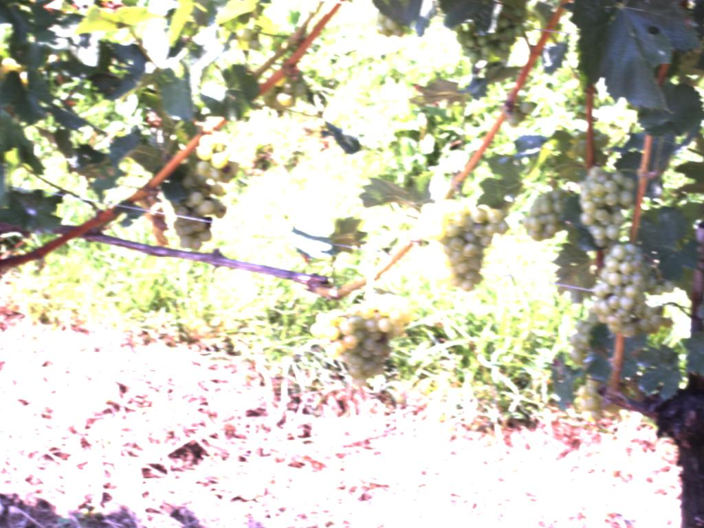
Why it will never work
“Burnt up” areas

Slide 9
Why it will never work
Blurry images

Slide 10
Every picture is special…
Filtering parameters
Window size
Grape radius
Histogram
Pre-processing functions

Slide 11

Can it be done automatically?

